Slide 1
Developing Secure Applications using Azure AD
Notes:
This module begins with a primer on OAuth 2.0 and OpenID Connect and an overview of the Azure Active Directory security model which provides support for user authentication, application authentication and an authorization scheme based on configurable permissions. Students will learn about the differences between application permissions and delegated permissions as well as how to create and configure Azure AD applications in the new Azure portal. Students will learn programming techniques for developing secure applications which implement common authentication flows such as user credentials flow, authorization grant flow, and client credentials flow. The module examines developing secure ASP.NET MVC application by using the Active Directory Authentication Library (ADAL) together with the OWIN framework and OWIN middleware components. The module also explains how to secure client-side SPAs created Angular and AngularJS by using the ADAL.js library and the implicit grant flow to acquire access tokens.

Slide 2
Agenda
Understanding OAuth 2.0 and OpenID Connect
The Role of Azure Active Directory
Creating & Configuring Azure AD Applications
Securing MVC Applications using ADAL and OWIN
Securing SPAs using ADAL.js & Implicit Grant Flow

Slide 3
Old-school Enterprise Security
Local AD Domain: WINGTIP.COM
NTLM/Kerberos

Slide 4
Internet Security
FaceBook
Google
Office 365
Power BI

Slide 5
OAuth 2.0
Resource service 1
User agent
End user working in browser
Client
Your Custom Application
Resource service 2
Authentication Flow
Resource service 3
access token
Authorization server
FaceBook, Google,
Twitter, GitHub
Azure Active Directory

Slide 6
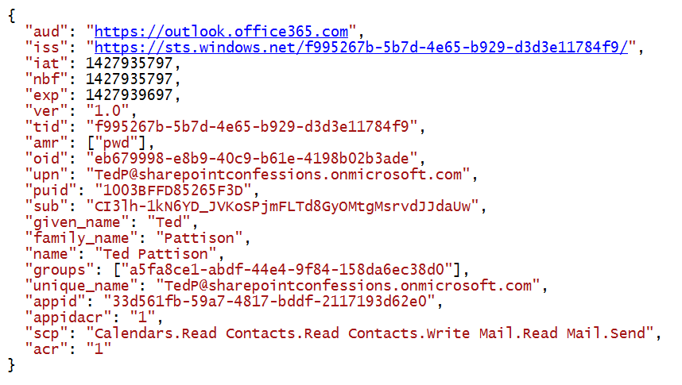
View into an Access Token

Slide 7
OAuth Client Registration
Client must be registered with authorization server
Authorization server tracks each client with unique Client ID
Client should be registered with one or more Reply URLs
Reply URL should be fixed endpoint on Internet
Reply URL used to transmit security tokens to clients
Client registration tracks permissions and other attributes

Slide 8
Authentication Flows
User Credentials Flow (public client)
Used in Native clients to obtain access code
Requires passing user name and password
Authorization Code Grant Flow (confidential client)
Client first obtains authorization code then access token
Server-side application code never sees user’s password
Client Credentials Grant Flow (confidential client)
Authentication based on SSL certificate with public-private key pair
Used to obtain access token when using app-only permissions
Implicit Grant Flow (public client)
Used in SPAs built with JavaScript and AngularJS
Application obtains access token w/o acquiring authorization code

Slide 9
OAuth 2.0 and Authentication
OAuth 2.0 was designed for authorization
Creation of access token requires authentication
Authorization server passes access token to client
Client passes access token when calling resource services
Access token serves as app credentials for authorization
Access token not intended for user authentication
Access token not designed to carry user identity data
OAuth 2.0 doesn't require validation of access token
Naïve OAuth 2.0 implementations subject to attack

Slide 10
Open ID Connect
Resource service 1
User agent
End user working in browser
Client (Relying Party)
Your Custom Application
Resource service 2
Authentication Flow
Resource service 3
Id tokens
Open ID Provider
FaceBook, Google,
Twitter, GitHub
Azure Active Directory

Slide 11
Agenda
OAuth 2.0 and OpenID Connect
Azure Active Directory
Creating Azure AD applications
Active Directory Authentication Library for .NET
Programming Web Clients

Slide 12
Tenants and Organizational Accounts
Azure AD used to authenticate users and apps
PBI licenses are assigned to Azure AD user accounts
Organization owns a tenant (i.e. directory)
AAD tenant contains user accounts and groups
AAD tenant contains set of registered applications
You must register your application with Azure AD
Requirement of calling to Power BI service API
Applications registered as Web app or Native app
Registered applications are assigned GUID for client ID
Application is configured with permissions

Slide 13
Agenda
OAuth 2.0 and OpenID Connect
Azure Active Directory
Creating Azure AD applications
Active Directory Authentication Library for .NET
Programming Web Clients

Slide 14
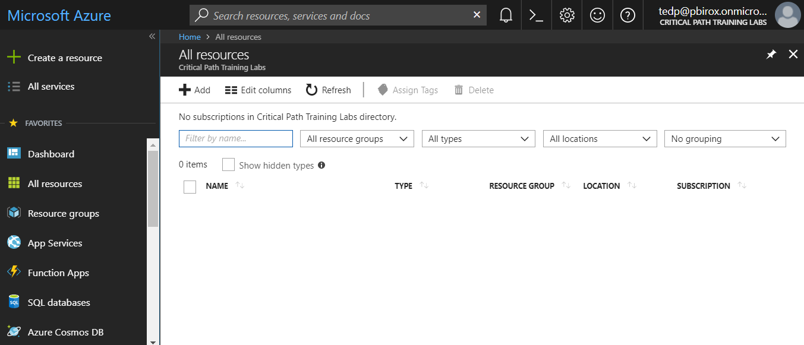
The Azure Portal
Azure portal allows to create application
Azure Portal accessible at https://portal.azure.com
Azure subscription required to create resources (e.g. VMs)
No Azure subscription required to manage users or applications

Slide 15
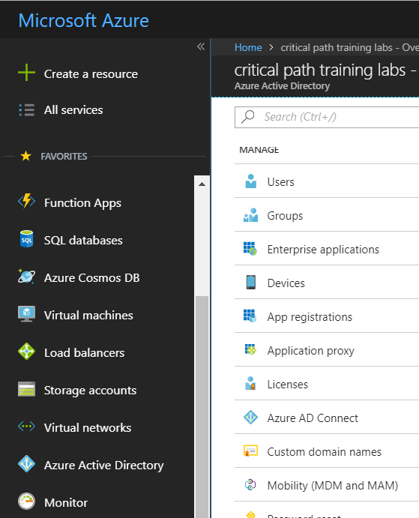
Azure Active Directory
Azure portal access to Access Azure Active Directory
Provides ability to configure users, groups and application

Slide 16
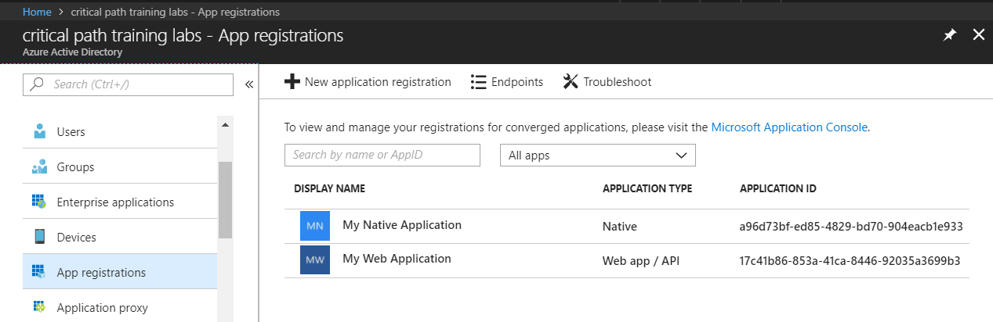
Azure AD Applications
Creating applications required for AAU authentication
Applications are as Native application or Web Applications
Application identified using GUID known as application ID
Application ID often referred to as client ID or app ID

Slide 17
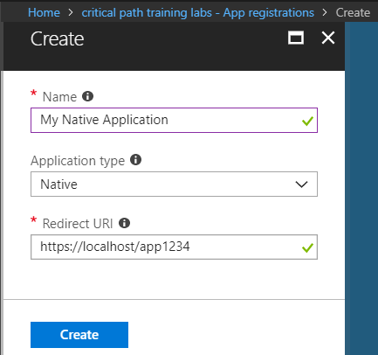
Creating a Native Application
Power BI supports Native applications
Can be used for desktop applications and Console applications
Used for third party embedding (known as App Owns Data model)
Application type should be configured as Native
Requires Redirect URI with unique string - not an actual URL

Slide 18
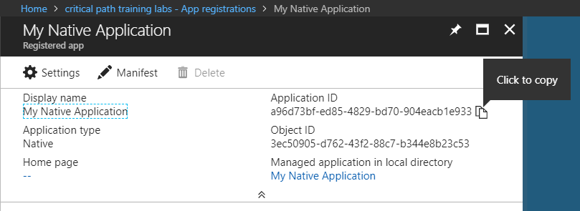
Copying the Application ID
Each new application created with Application ID
You cannot supply your own GUID for application ID
Azure AD will always create this GUID
You can copy the application IS from the azure portal

Slide 19
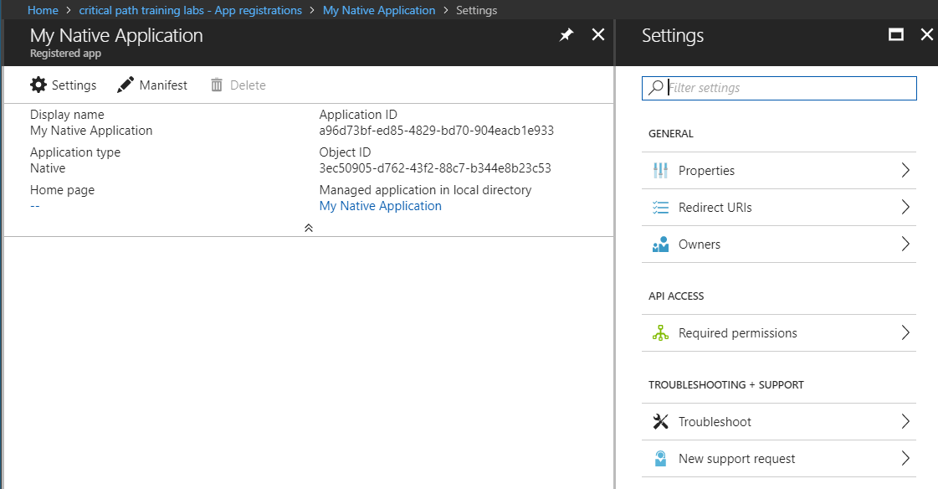
Native Application Settings
Properties
Redirect URLs
Owners
Required Permissions

Slide 20
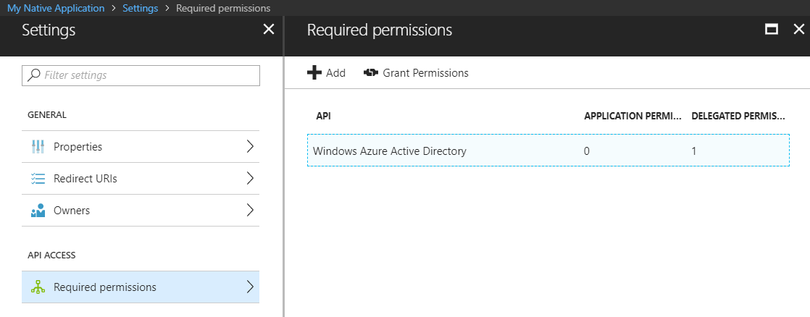
Configuring Required Permissions
Application configured with permissions
Default permissions allows user authentication – but that's it
To use APIs, you must assign permissions to the application

Slide 21
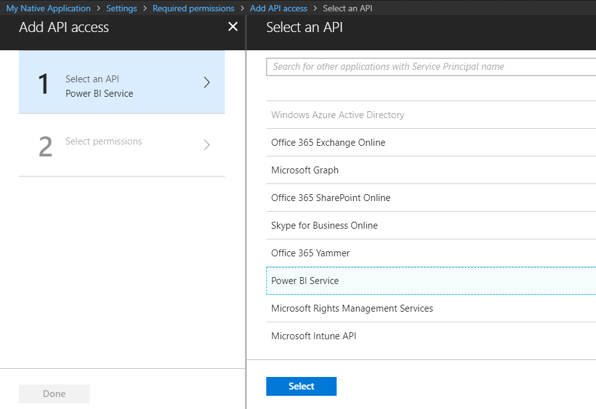
Choosing APIs
There are lots of APIs to choose from
Microsoft Graph
Office 365 SharePoint Online
Power BI Service

Slide 22
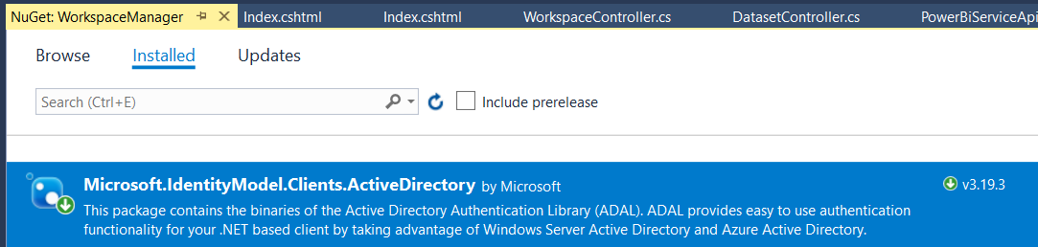
ADAL for .NET
Active Directory Authentication Library for .NET
Used in Native Clients and in Web Clients
Handles authentication flow behind the scenes
Provides caching for access tokens and refresh tokens
ADAL .NET installs as a NuGet Package
Package name is Microsoft.IdentityModel.Clients.ActiveDirectory

Slide 23
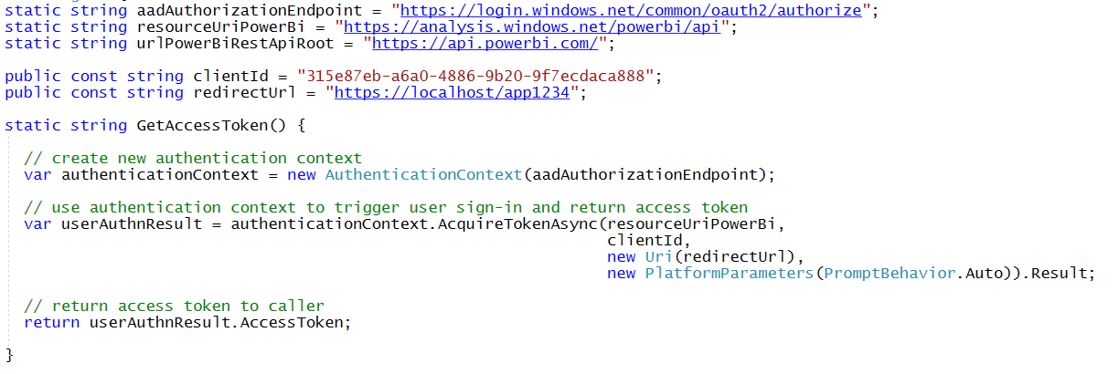
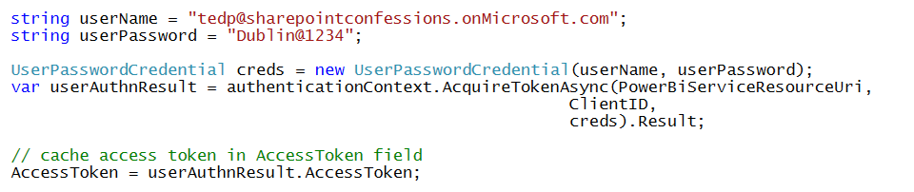
Access Token Acquisition (Native Client)
With interactive login
With Direct User Credentials (non-interactive)

Slide 24
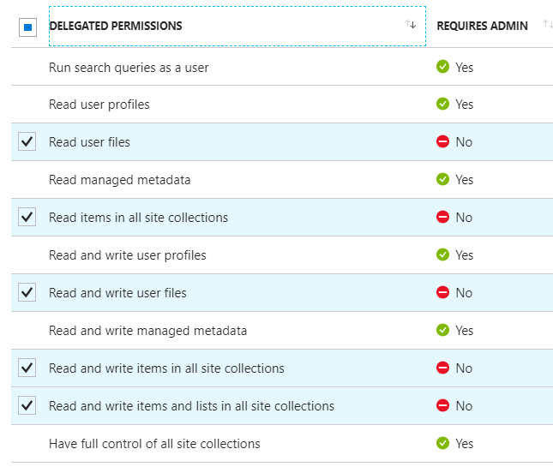
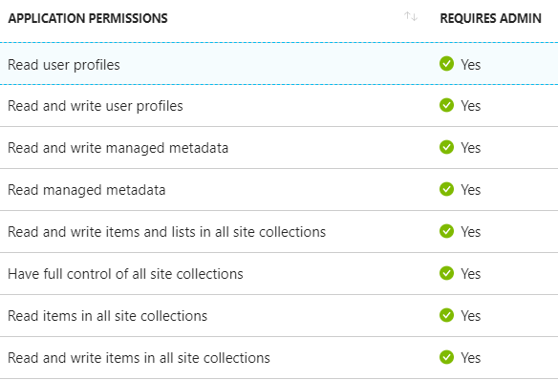
Delegated Permissions vs Application Permissions
Permissions categorized into two basic types
Delegated permissions are (app + user) permissions
Application permissions are app-only permissions (far more powerful)
Not all application types and APIs support application permissions
Power BI Service API does not yet support application permissions
Example permissions for Office 365 SharePoint Online
Some delegated permissions requires administrative permissions

Slide 25
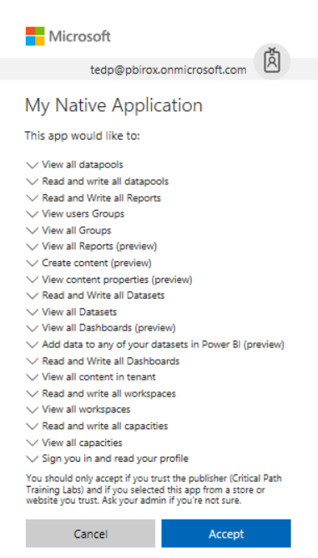
Interactive Consent for Delegated Permissions
Users must consent to delegated permissions
User prompted during first log in
User must click Accept
Only occurs once for each user

Slide 26
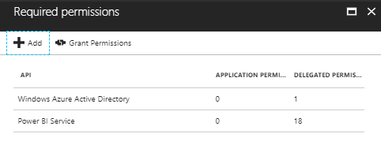
Granting Delegated Permissions
It can be helpful to Grant Permissions in Azure portal
Prevents the need for interactive granting of application by user
Might be required when authenticating in non-interactive fashion

Slide 27
Single versus Multi-tenant
Single tenant application
intended for use within a single organization
line-of-business applications written by an Office 365 developer
only needs to be accessed by users in one Office 365 tenancy
typically registered by a developer in the organization
Multi-tenant application
intended for use across many organizations
software-as-a-service (SaaS) applications written by ISVs
need to be provisioned in each directory where they will be used
requires user or administrator consent to register them

Slide 28
Creating an AAD Application

Slide 29
Agenda
OAuth 2.0 and OpenID Connect
Azure Active Directory
Creating Azure AD applications
Active Directory Authentication Library for .NET
Programming Web Clients

Slide 30
ADAL for .NET
Active Directory Authentication Library for .NET
Used in Native Clients and in Web Clients
Handles authentication flow behind the scenes
Provides token cache
ADAL .NET installs as a NuGet Package
Version 2.x is latest stable version
Version 3.x is in prerelease

Slide 31
Using ADAL in a Native Client

Slide 32
Agenda
OAuth 2.0 and OpenID Connect
Azure Active Directory
Creating Azure AD applications
Active Directory Authentication Library for .NET
Programming Web Clients

Slide 33
Authentication Code Flow
Provides Highest Levels of Security
User credentials never seen by client
Access token passed to client with Reply URL
Access token not passed through user agent
Refresh tokens used to get new access tokens
Access token lifetime is about 1 hour
Refresh token lifetime is 14 days
AAD supports multi-resource refresh tokens (MRRTs)

Slide 34
Authorization Code Grant Flow Example
Sign-on URL
Development: https://localhost:44300/
Production: https://www.MyDomain.com/
Reply URL
Development: https://localhost:44300/AcceptDirect
Production: https://www.MyDomain.com/AcceptDirect
Application ID URI
String-based identifier for an application – not a retrievable URL
https://sharepointconfessions.onmicrosoft.com/HelloWorldApp
Client ID
GUID-based identifier for a specific AAD application
33d561fb-59a7-4817-bddf-2117193d62e0
Key (aka Client Secret)
Key that acts as a secret password between Azure AD and application
ouWdhd2LxDl0Pcu2SKlujEiQ5GmSbKRbBM24nETb5dw=

Slide 35
Authorization Code Grant Flow
Sequence of Requests in Authorization Code Grant Flow
Application redirects to AAD authorization endpoint
User prompted to log on at Windows logon page
User prompted to consent to permissions (first access)
AAD redirects to application with authorization code
Application redirects to AAD access token endpoint
Request authorization code
Sign-in via browser pop-up
Return authorization code
Redeem authorization code and acquire access token for Office 365 resource
Return access token and refresh token
Call Office 365 API using the access token
Return Http Response
Authorization Endpoint
Token Endpoint
Client Application
Office 365 API

Slide 36
Using ADAL in a Web Client

Slide 37
Summary of OAuth Client Types
 | Web Client SPA | Hybrid Native Client | Web Application Client | Web Service Client
Client Type | Public | Public or Confidential | Confidential | Confidential
Verifiable Reply URL | Yes | No | Yes | Yes
Authenticates Client | No | It Depends | Yes | Yes
Token from Authorization Endpoint | Yes | Yes | No | No
Access Token from URI Fragment | Yes | No | No | No
Token from Token Endpoint | No | Yes | Yes | Yes
Can use refresh tokens | No | Yes | Yes | Yes
Permissions | Delegated | Delegated + App | Delegated + App | Delegated + App

Slide 38
Summary
OAuth 2.0 and OpenID Connect
Azure Active Directory
Creating Azure AD applications
Active Directory Authentication Library for .NET
Programming Web Clients

